Slide 1

XAIVER INTERNATIONAL COLLEGE
Boddha, Tusal
DEPARMENT OF COMPUTER SCIENCE & INFORMATION TECHNOLOGY
Notes:
1

Slide 2

Fitly
Exercise & Meal Planning App
Submitted by: Anju Shrestha
Roll no: 6-2-546-23-2021
supervised by: Roshan jha
Notes:
2

Slide 3
List of Contents
  Introduction and Type of project
  *Type of project means either website/mobile app/research based project
  Objectives / Goals
  Requirements
  Project Design
    Conceptual / Logical Design
      ERD, USE CASES
    Physical Design
      Backend Design (Database)
    Front End Design
      Tools
      Screen shorts of your system
  Contributions (Achieved Objectives / Goals)
3

Slide 4
Introduction and Type of project
  What is Fitly? An AI-powered web app for fitness and meal planning.
  Type: Full-stack Web Application.
  Why? Current apps offer generic plans or only cover either diet or workouts.
  How? Built using the MERN stack with AI integration via Google Gemini for dynamic planning.
4

Slide 5
Objectives / Goals
Objectives :
  Personalized AI-generated meal plans.
  Tailored exercise routines based on fitness level.
  Progress tracking through an interactive dashboard.
  Reduce dependency on expensive trainers or dietitians.
  Foster long-term engagement with motivational support.
5

Slide 6
Requirements
Functional :
  User Registration and Profile Setup
  Meal Plan Generation via Gemini
  Workout Plan Generation
  Daily Tracking Dashboard
  Conversational AI chatbot
  Non-Functional :
  Performance (load ≤ 5s)
  Cross-browser & device compatibility
  Scalable backend on Render
  Secure (JWT, bcrypt)
  Simple, guided UI
6

Slide 7
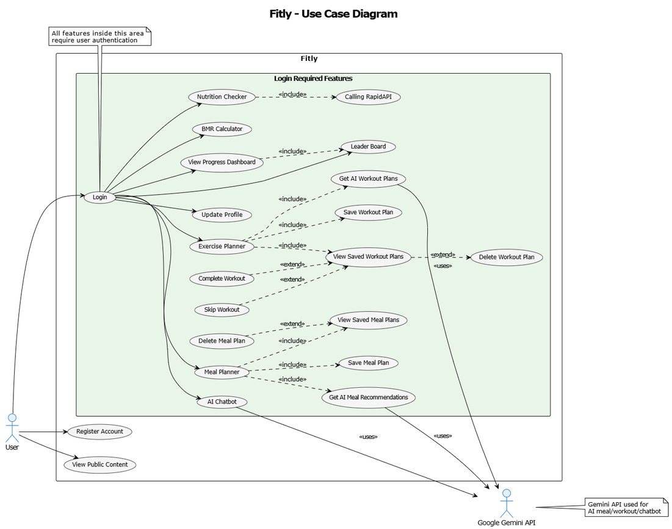
Project Design
Usecase Diagram
7

Slide 8
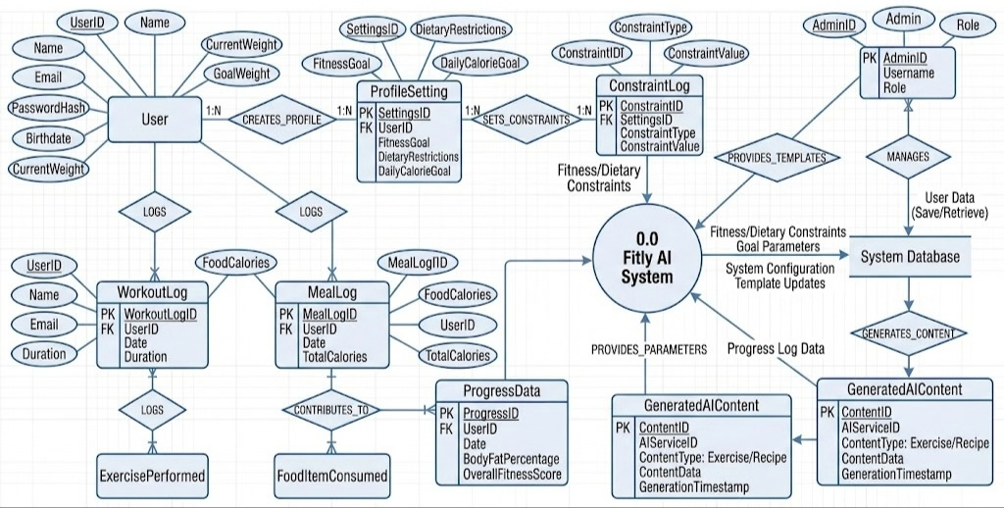
ER Diagram
  ER Diagram:
8

Slide 9
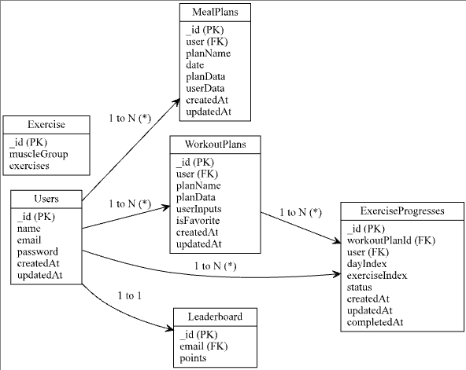
Project Design
    Physical Design
      MongoDb atlas
Blueprint
n
9

Slide 10
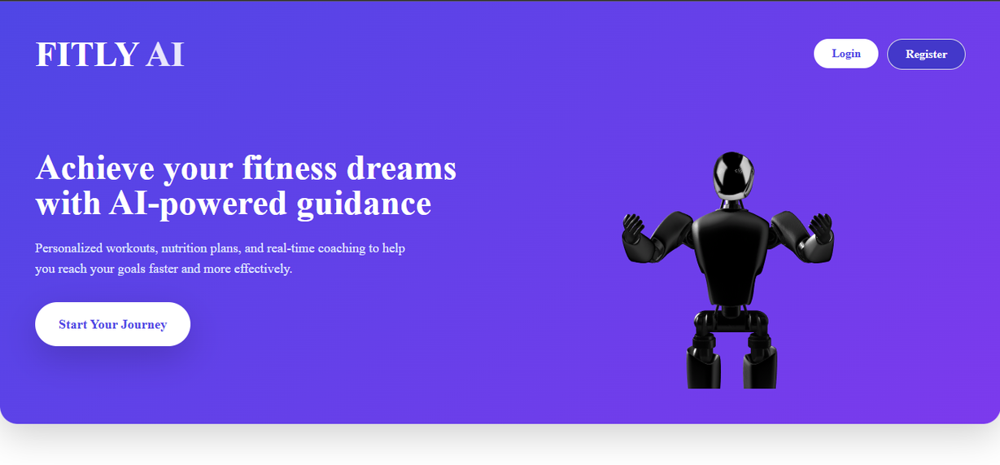
Project FrontEnd Design
1 : Landing Page.
10

Slide 11
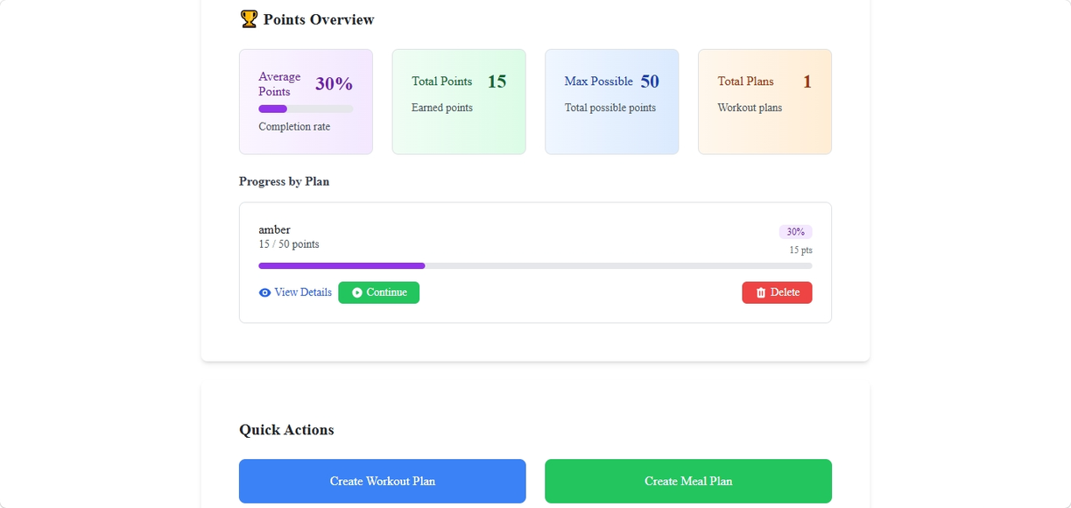
Project FrontEnd Design
2 : Dashboard .
11

Slide 12
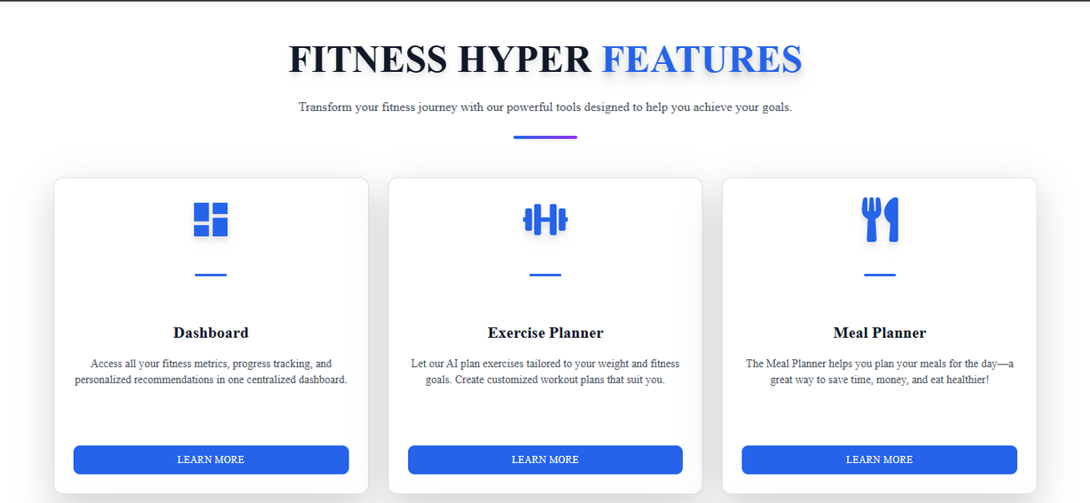
Project FrontEnd Design
3 : Features.
12

Slide 13
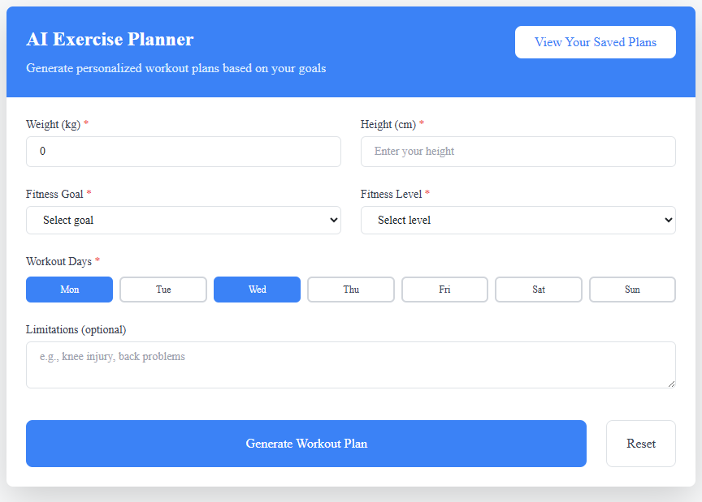
Project FrontEnd Design
4 : Exercise Planner.
13

Slide 14
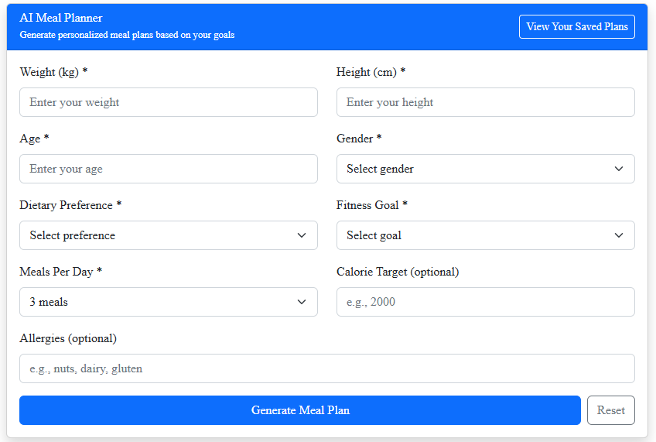
Project FrontEnd Design
5 : Meal Planner.
14

Slide 15
Contributions
  Functional AI-based meal/workout planner
  Fully responsive dashboard with charts
  Integrated Google Gemini API
  Secure authentication (JWT + bcrypt)
15

Slide 16
Thank You
16

